Slide 1

A CD of this message will be available (free of charge) immediately following today's message
This message will be available via podcast later this week at calvaryokc.com
2 Samuel
01-02

Slide 2

2 Samuel
01-02

Slide 3
2 Samuel
01-02

Slide 4
2 Samuel
01-02
Book divided into 2 parts
Chapters 1-12 ~ David's triumphs
Chapters 12-24 ~ David's troubles

Slide 5
2 Samuel
01-02

Slide 6
2 Samuel
01-02
Gen. 2:17 ~ but you must not eat from the tree of the knowledge of good and evil, for when you eat of it you will surely die.
Gen. 3:4 ~ "You will not surely die," the serpent said to the woman.
Luke 5:21 ~ The Pharisees and the teachers of the law began thinking to themselves, "Who is this fellow who speaks blasphemy? Who can forgive sins but God alone?"
1 Pet. 2:22 ~ He committed no sin, and no deceit was found in his mouth.

Slide 7
2 Samuel
01-02

Slide 8
2 Samuel
01-02
(Song of) the Bow
(Use of the) bow (KJV)

Slide 9
2 Samuel
01-02

Slide 10
2 Samuel
01-02
Lost books from the Bible:
Book of Jasher (Upright) ~ here and Joshua 10:13
Book of the Wars of the Lord ~ Num. 21:14
Books of the Chronicles of the Kings of Israel ~ 1 & 2 Kings
Books of the Chronicles of the Kings of Judah ~ 1 & 2 Kings
Several prophets: Gad, Iddo, Nathan, Ahijah, et al

Slide 11
2 Samuel
01-02

Slide 12
2 Samuel
01-02
Not anointed with oil
KJV. as though he had not been
NIV, no longer rubbed

Slide 13
2 Samuel
01-02

Slide 14
2 Samuel
01-02
Esh-baal (1 Chron. 8:33) fire (or man) of the Lord
Ishbosheth ~ man of shame

Slide 15
2 Samuel
01-02

Slide 16
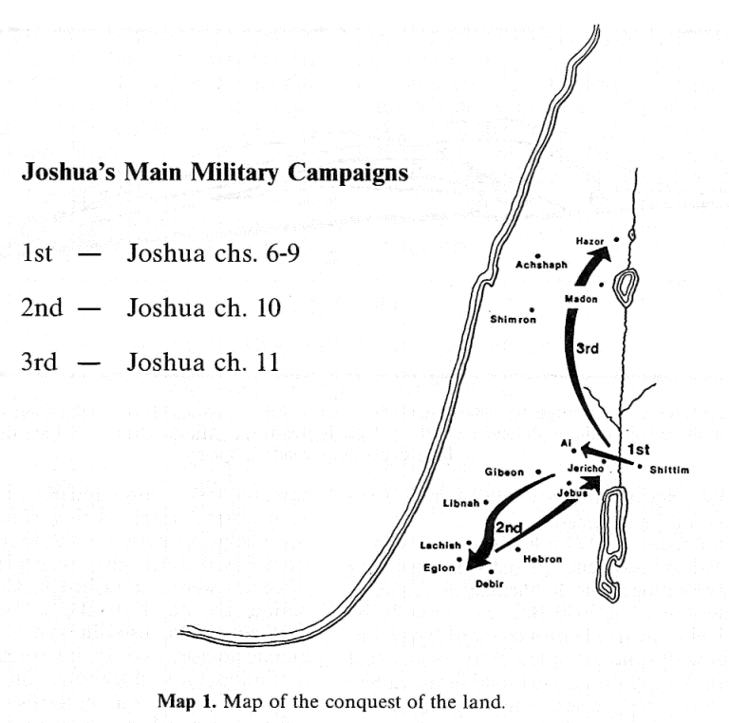
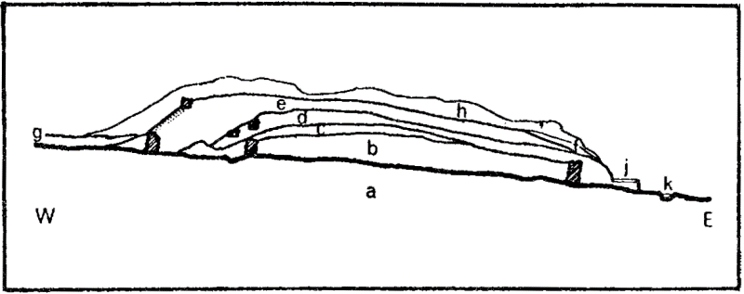
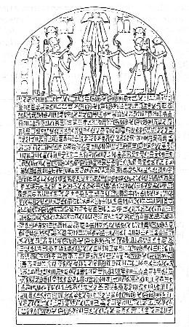
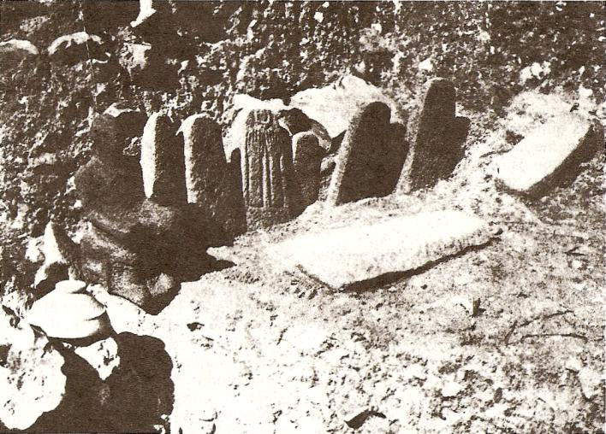
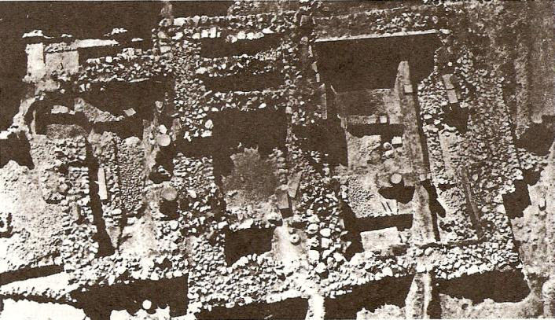
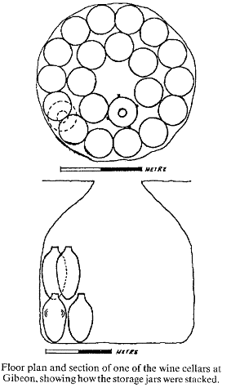
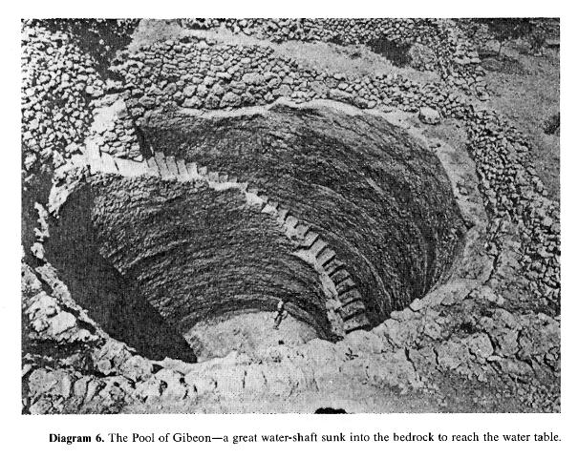
2 Samuel
01-02

Slide 17
2 Samuel
01-02

Slide 18
2 Samuel
01-02
Field of Sharp Swords ~ KJV, NIV, NASB ~ Helkath Hazzurim.

Slide 19
2 Samuel
01-02

Slide 20
2 Samuel
01-02
Stomach ~ KJV, fifth rib

Slide 21
2 Samuel
01-02

Slide 22
2 Samuel
01-02
NIV ~ if you had not spoken, the men would have continued the pursuit of their brothers until morning.

Slide 23
2 Samuel
01-02

Slide 24
2 Samuel
01-02
Alan Redpath ~ "In the lives of many Christian people today there is raging, literally, a civil war. The flesh - the kingdom of Saul, struggles with the spirit - the kingdom of David, and the conflict is bitter. We do everything we possibly can to hold up the tottering kingdom of self, so that it might exist just a bit longer. If only we could preserve some rights; if only we could have at least part of our own way; if only we could keep this or that at any cost! We feel we must bolster up this kingdom of self, that we cannot let ourselves be crucified with Christ."

Slide 25
2 Samuel
01-02

